Slide 1
GPipe: Efficient Training of Giant Neural Networks using Pipeline Parallelism
PipeDream: Generalized Pipeline Parallelism for DNN Training
HetPipe: Enabling Large DNN Training on (Whimpy) Heterogeneous GPU Clusters through Integration of Pipelined Model Parallelism and Data Parallelism

Slide 2
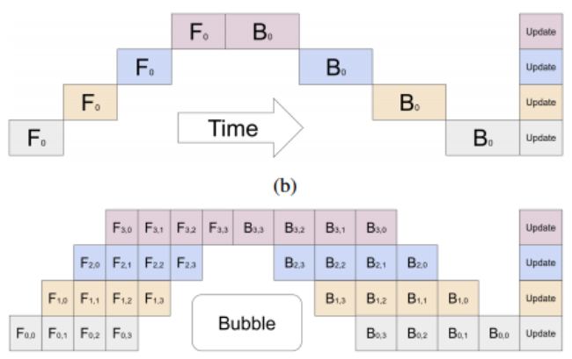
GPipe: Efficient Training of Giant Neural Networks using Pipeline Parallelism
At the end of each mini-batch, gradients from all M micro-batches are accumulated and applied to update the model parameters across all accelerators.
we found the bubble overhead to be negligible when M ≥ 4 × K.
GPipe achieves almost linear speedup with the number of devices.

Slide 3
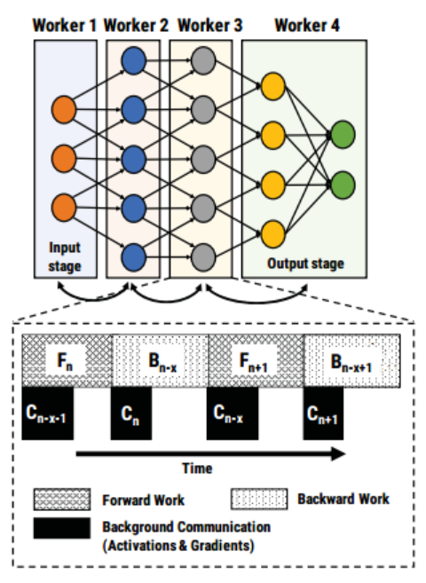
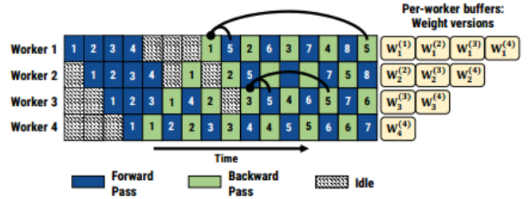
PipeDream: Generalized Pipeline Parallelism for DNN Training
Once in steady state, each stage alternates between performing its forward pass for a minibatch and its backward pass for an earlier minibatch. It also ensures backward passes from inputs are applied at regular intervals of time.

Slide 4
同一个stage前向后向使用的参数不同
不同stage前向后向参数版本差距不同
Weight stashing ensures that within a stage, the same version of model parameters are used for the forward and backward pass of a given minibatch.
Vertical sync: Each minibatch that enters the pipeline is associated with the latest weight seen at the input stage.

Slide 5



更新后的参数不能马上使用

Slide 6
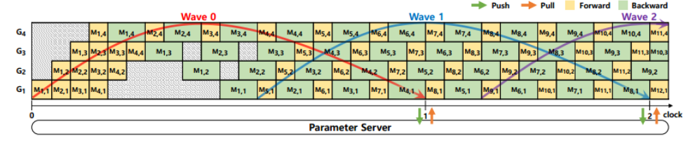
HetPipe: Enabling Large DNN Training on (Whimpy) Heterogeneous GPU Clusters through Integration of Pipelined Model Parallelism and Data Parallelism
当第一个stage完成梯度计算后，所有stage更新本地参数 (Weight stashing + Vertical sync)
A wave is a sequence of minibatches that are processed concurrently in a virtual worker.
a clock unit is defined as the progress of completing one wave.
clock结束时将梯度传到参数服务器，从参数服务器取全局参数（可能等待其他流水线传递梯度到参数服务器）
Let clock distance be the difference in clocal between the fastest and slowest virtual workers in the system.（超参）

Slide 7
clock distance=0:
VW1 now waits for the other virtual workers to complete wave 0 before proceeding with minibatch 8. However, note that as shown in the figure, VW1 has already startedto process minibatches 5, 6 and 7, which belong to wave 1, while its local clock is still 0.
Actually, the weight version used for minibatch 11 includes three local updates from minibatches 5, 6, and 7, along with all the global updates from wave 0. In case of minibatch 12, it cannot start the training until global updates up to minibatch 8 are received.

